Slide 1

Elements of Story

Slide 2
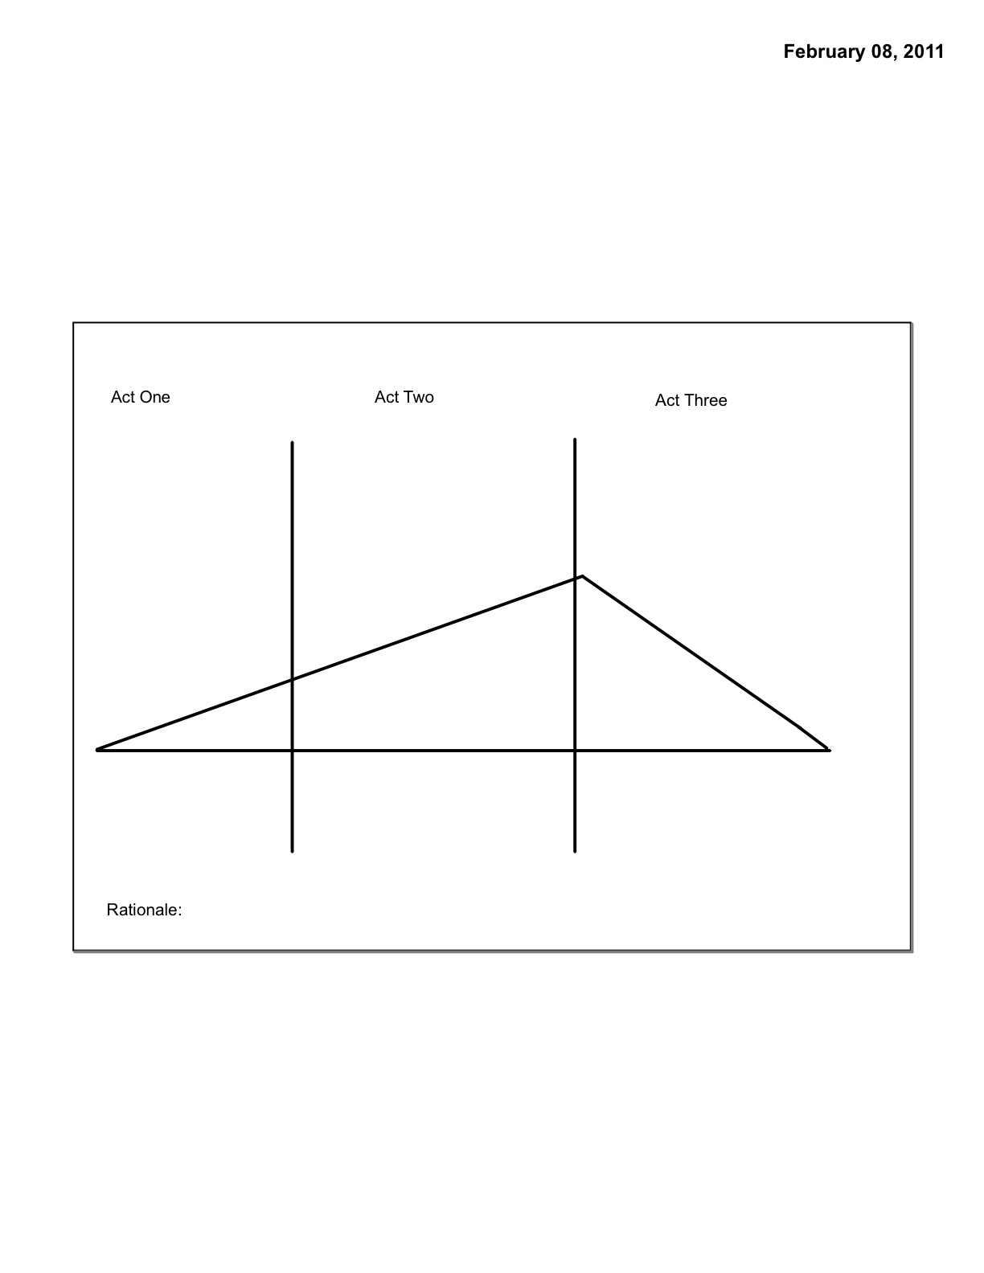
Plot: Three Act Structure

Slide 3
Act One
Exposition
Inciting Incident

Slide 4
Exposition
Main characters, story’s general mood is set, physical setting exposed
  Who, what, where, when

Slide 5
Inciting Incident
An event in the first act that sets the plot in motion
Happens about half-way through the first act
  Feature Film=first 15 min.
  Television sitcom or short film, first 2-5 min.

Slide 6
Plot: Three Act Structure

Slide 7


Slide 8
Act Two
Rising Action
Turning Point

Slide 9
Rising Action
Obstacles that prevent main character from achieving goal
First Culmination: main character is close to achieving goal, then everything falls apart.
Midpoint: halfway through where main character reaches lowest point and seems farthest from fulfilling goal.

Slide 10
Turning Point
Point of climax, marks the end of Act 2/beginning of Act 3
The plot reaches its maximum tension and the forces in opposition confront each other at a peak of physical or emotional action.

Slide 11
Plot: Three Act Structure

Slide 12
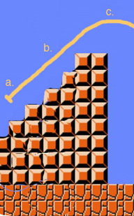

Slide 13
Act Three
Falling Action
Resolution

Slide 14
Falling Action
Action that occurs as a direct result of the turning point

Slide 15
Resolution
Final state of characters and action of the film

Slide 16
Plot: Three Act Structure

Slide 17
